Slide 1
WELCOME PARENTS!
Per. 1 5:45-5:55
Per. 2 6:00-6:10
Per. 3 6:15-6:25
Per. 4 6:30-6:40
Per. 5 6:45-6:55
Per. 6 7:00-7:10
English 11CP
Mrs. Lonna Rojas
Room B104

Slide 2
WHEN A STUDENT NEEDS HELP:
After-school help here in B104 or by appointment (lunch/before school)
Student can also contact me via Remind or Email: Lonna_Rojas@chino.k12.ca.us
Remind Class Codes
for all periods
@rojas11cp
Text the code for your child’s class to 81010

Slide 3
My Expectations The 3 Bs
Be Respectful to peers, teacher, learning environment, and yourself.
Be Responsible, prepared, focused, and attentive. Follow all school rules (tech stays in backpack!).
Be Safe
by maintaining academic integrity and reporting unsafe/unethical behavior. See something, say something.

Slide 4
My Expectations The 3 Bs
in detail!

Slide 5
American
LITERARY PERIODS:
Native American
Puritan/Colonial
Revolutionary
Age of Reason
Romanticism
Transcendentalism
Realism
Modern

Slide 6
READINGS:
major
our
TEXTBOOKS:
The Crucible is in MyPerspectives VOLUME 2
Speeches are in MyPerspectives VOLUME 1
The Great Gatsby - novel that students can purchase or check out from our school library
Fall
Native American Myths
“Sinners in the Hands of an Angry God” by Edwards
The Crucible, by Arthur Miller
Foundational Speeches by Jefferson, etc.
Spring
Writers such as Irving, Emerson, Thoreau, Poe
Civil War Era literature
The Great Gatsby, by F. Scott Fitzgerald
→ Must bring books to class!

Slide 7
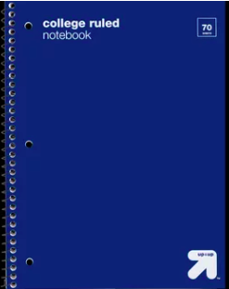
TYPES OF ASSIGNMENTS
common
Notebook- Cornell Notes and warm up activities must be completed in a physical spiral notebook.
Vocabulary Mondays / Quizzes Fridays (need to know words, roots, part of speech, how to place words in context)
Independent Reading / a grade level appropriate book chosen by student and approved by parent
Close Reading (Students need to identify techniques the writer used and the effects)
Presentations (Informal/Formal, Impromptu/Prepared)
In Class On Demand Writing - must be completed in class and submitted to Turnitin.com or per instructions
Tests/ Projects

Slide 8
TURNITIN.COM
Students must turn in most writing assignments online
Identifies plagiarism by highlighting text/phrases that are identical to other documents
REQUIRED for grading

Slide 9
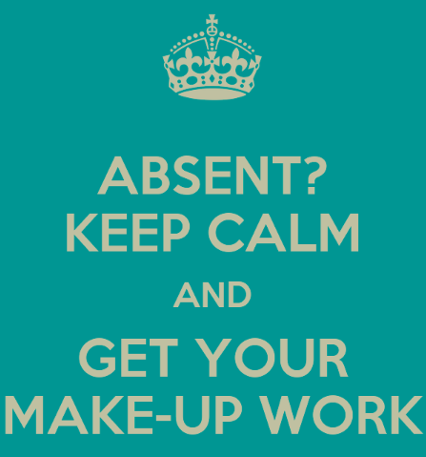
ABSENT WORK POLICY
1 day allowed to make up work for every day Excused
Student’s responsibility to find out make up work
Students must label/ communicate absent work (Ex: Absent Aug. 24)
Absent work must be submitted to the proper location or it will be missing or late

Slide 10
LATE WORK
POLICY
Ask questions and get help needed before due dates.
I try to give p l e n t y of time before deadlines.
I do accept Renaissance Card rewards (OOPS or HW Pass) to forgive 1 day of lateness.
Late work subject to ½ credit deduction of points earned if it is accepted
Zero late work will be accepted after a unit is completed or in the last week of the semester

Slide 11
WEIGHTED GRADES
70% Assessment 30% Student Work
% Grade Scale
98-100 A+
93-97 A
90-92 A-
88-89 B+
83-87 B
80-82 B-
78-79 C+
73-77 C
70-72 C-
68-69 D+
63-69 D
60-62 D-
0-59 F
40% Student Work & Participation
60% | Assessments (Tests, Projects, Essays)
10% | Vocab Quizzes
10% | Vocab Work
20% | Classwork/ Homework

Slide 12
Check GRADES on Aeries Parent Portal
If your student is new, create an account with the email address you provided to our school.
Student Permanent ID Number
Primary Email Address Provided
10 digit Verification Passcode

Slide 13
AYALA’S WEBSITE: GOOGLE CLASSROOM:
Class info on Check student’s work on
Look here to easily find information about the teacher/class
www.chino.k12.ca.us/ayala
Email Address
Syllabus
Class Expectations 3 Bs
Remind Code
Most assignments are posted here!
Your student can check here if absent, AND follow up with classmates and teacher to learn other details missed while absent.
You can LOG IN TO YOUR STUDENT’S ACCOUNT or ask them to show you. Example:

Slide 14
QUESTIONS? Please contact me
Email: Lonna_Rojas@chino.k12.ca.us
Other ways to reach me:
Remind app
Parent Square app
Expect a reply within 24-48 hours

